Slide 1
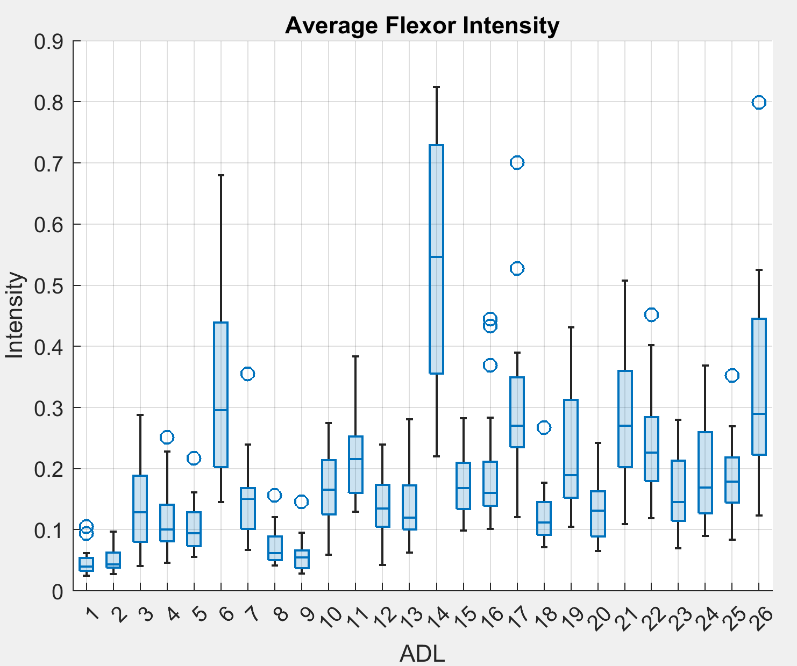
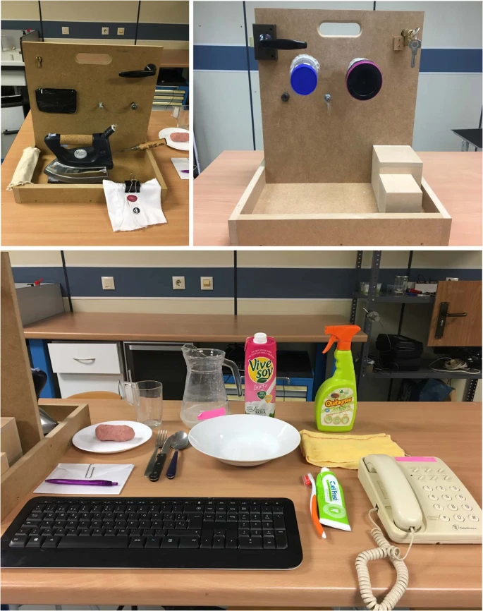
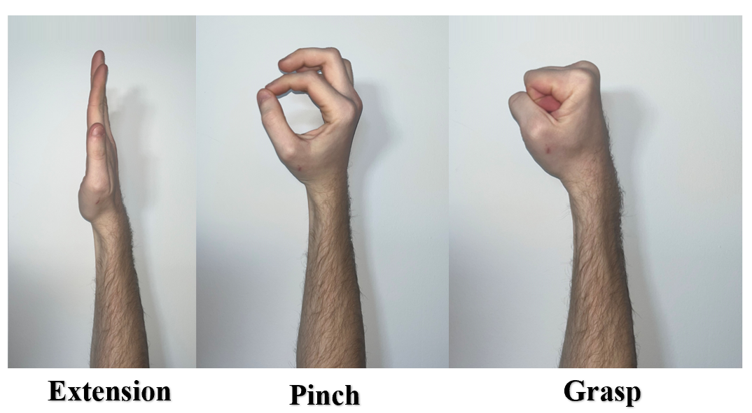
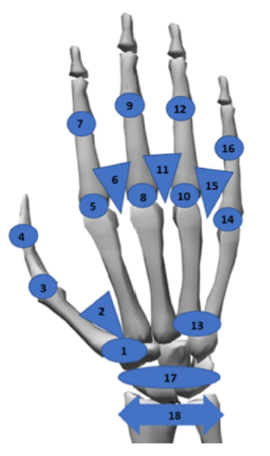
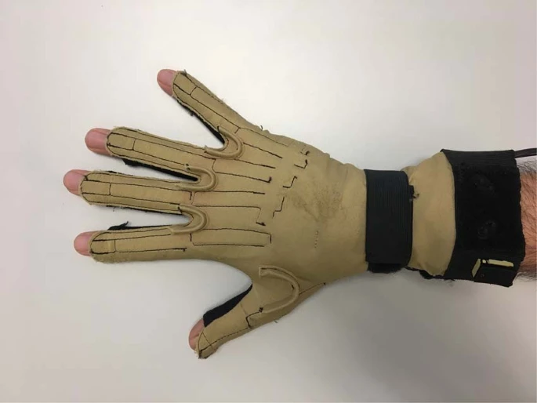
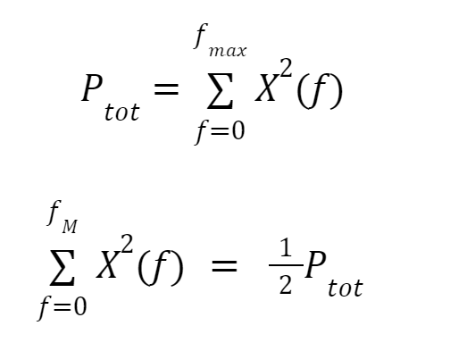
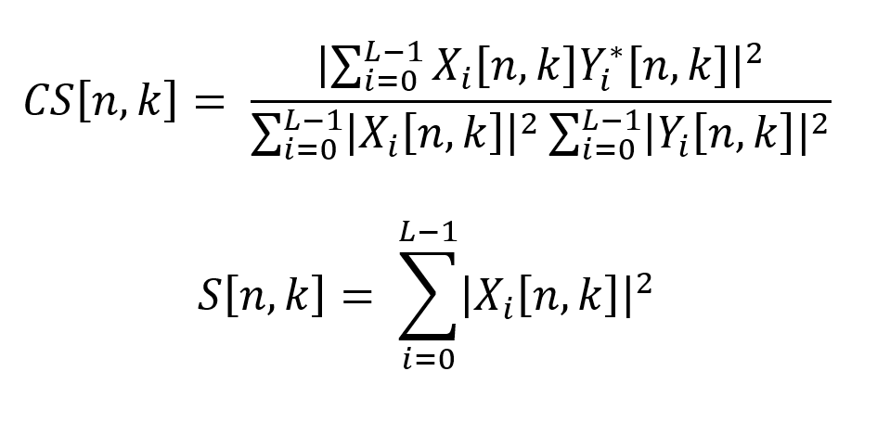

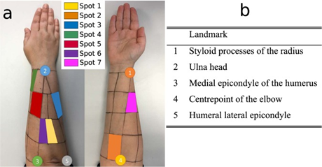
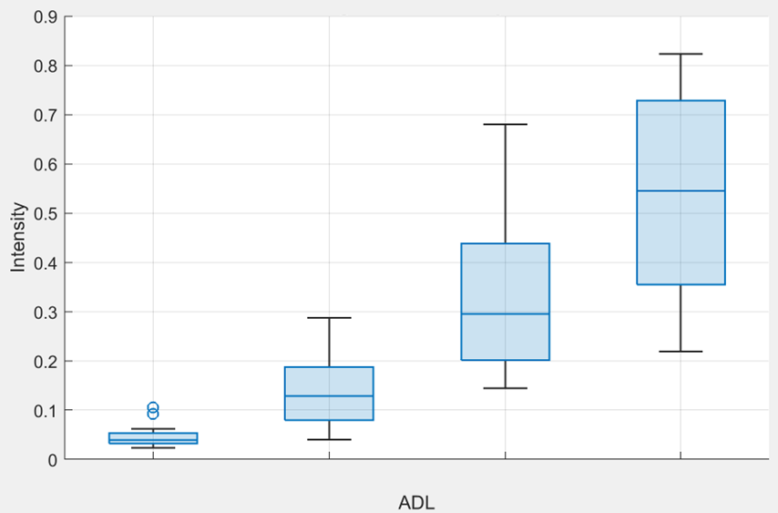
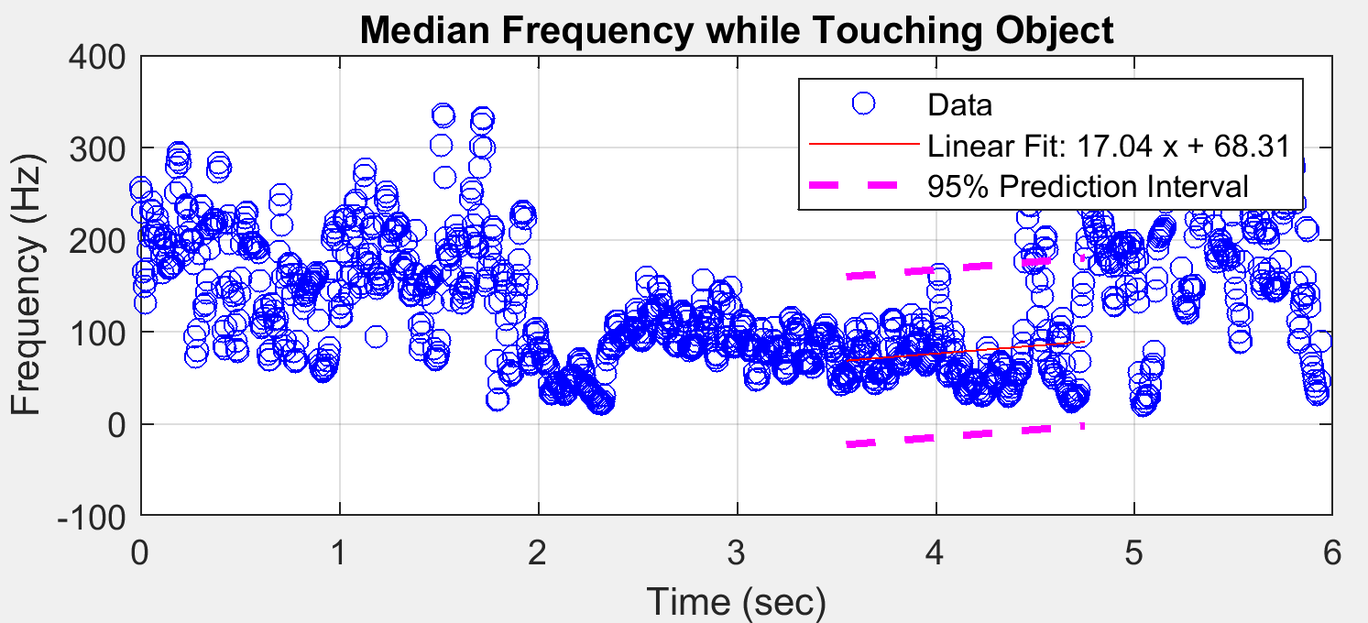
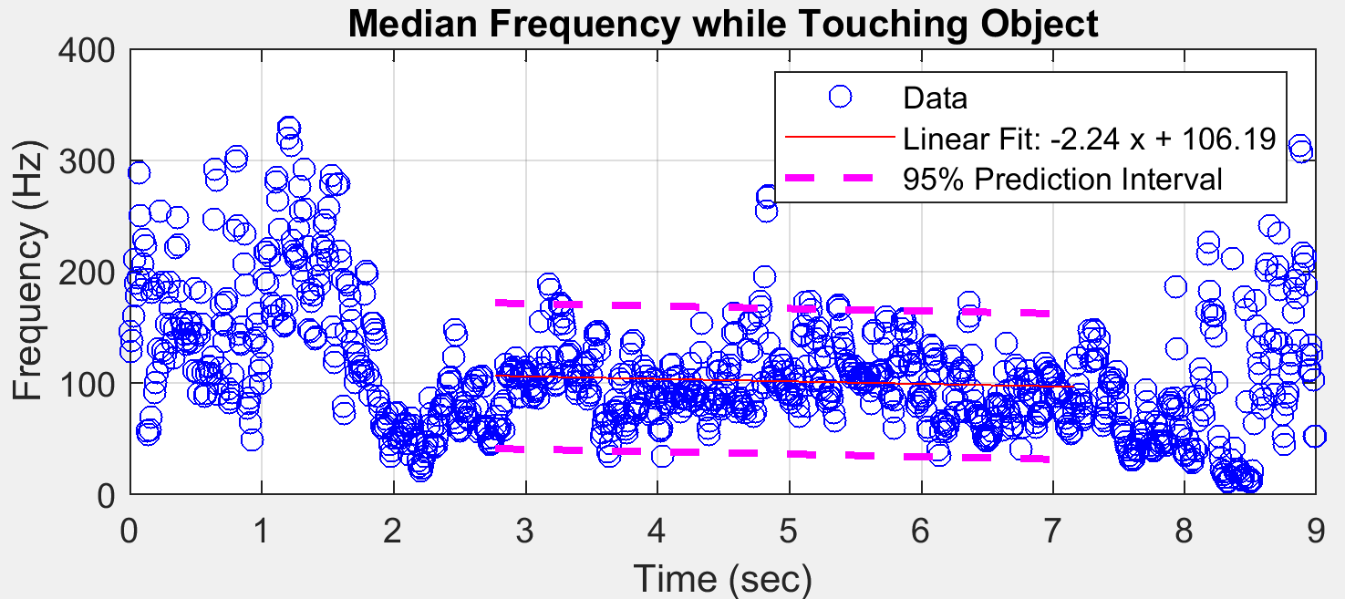
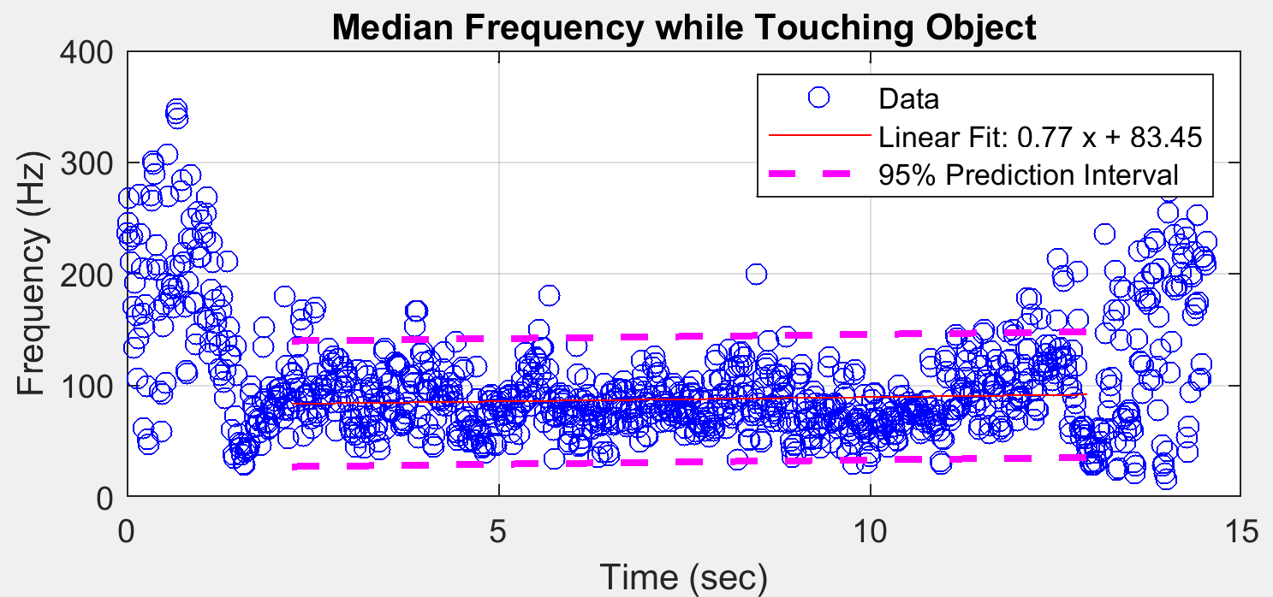
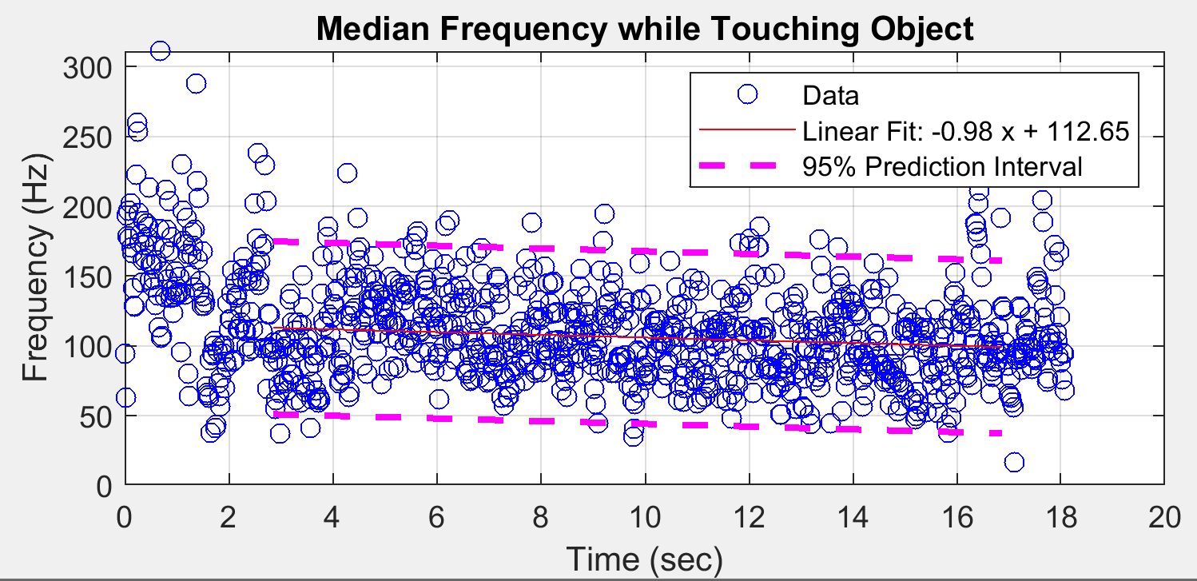
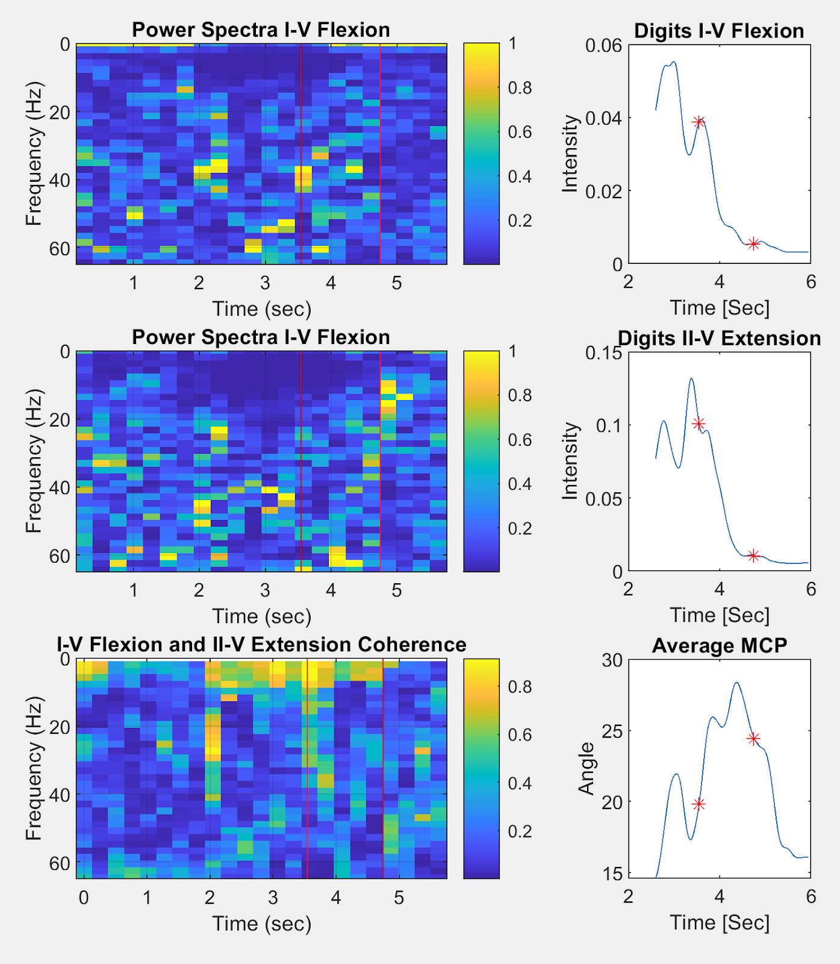
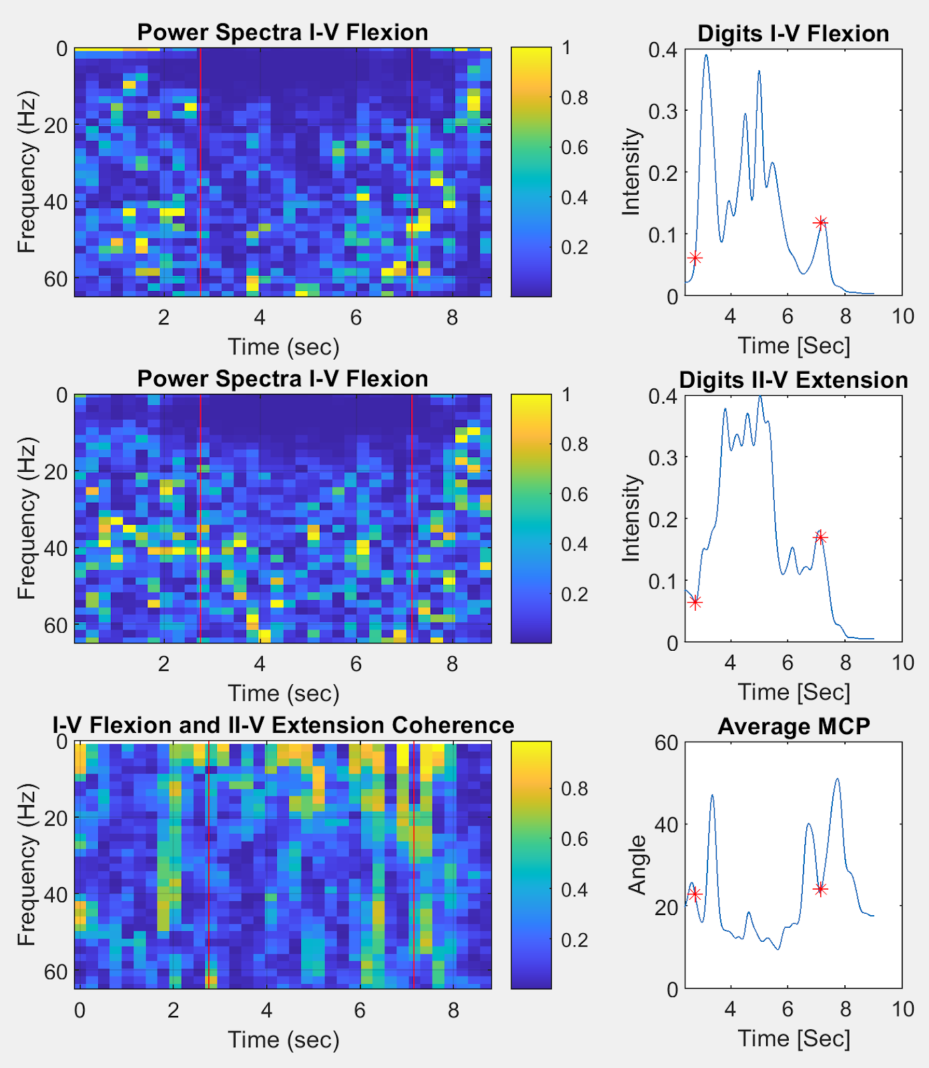
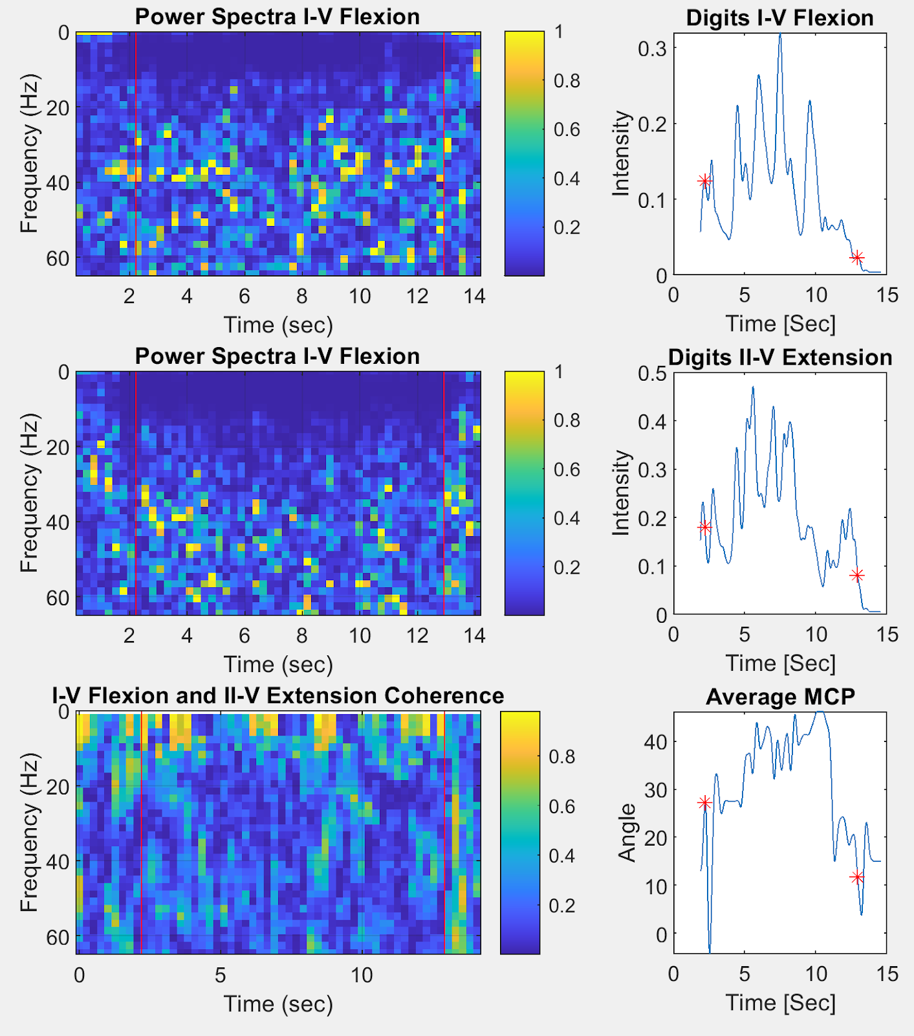
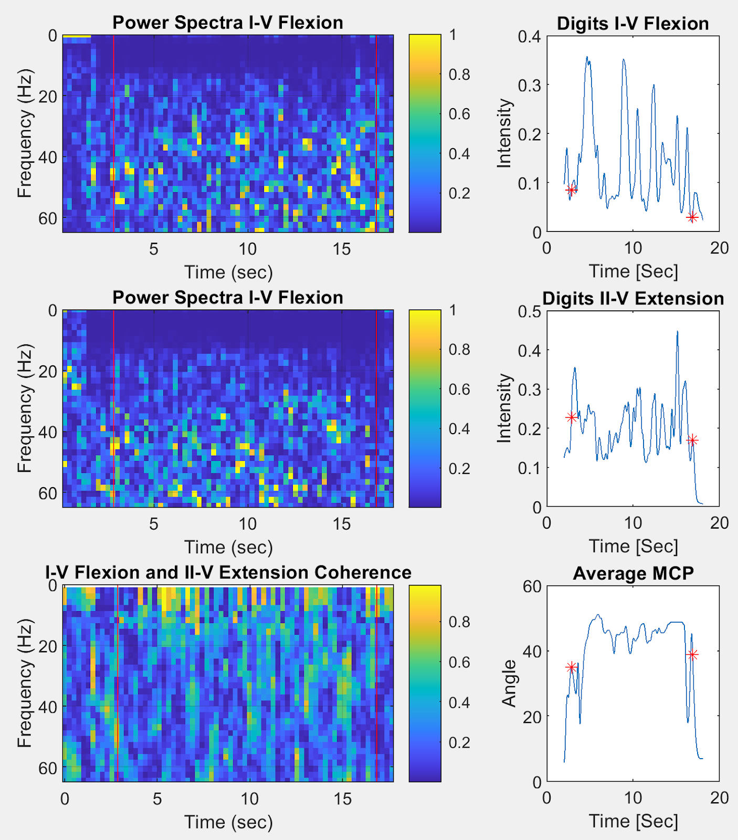
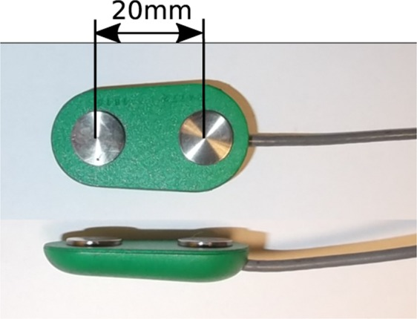
Introduction
Differentiating Pinch and Grasp using Forearm sEMG
Dataset of 22 patients hand joint angles and sEMG
26 Activities of Daily Living (ADL)
sEMG data from seven locations
Hand recorded in 18 Degrees of Freedom (DOF)
Brendan P. Beauchamp
School of Engineering
Grand Valley State University
Grand Rapids, Michigan beauchab@mail.gvsu.edu
Abstract
This paper applies sEMG enveloping, median frequency, and coherence to the Sollerman Hand Function Test Dataset recorded by Jarque Bou et al in order to differentiate sEMG activity during pinching and grasping tasks. Pinches and Grasps were found to cause very different activation patterns in sEMG spot 3 relating to flexion of digits I - V. Median frequency was found to be less correlated with differentiation and provided information about the degree of object manipulation performed during each task. Coherence was shown to increase between flexors and extensors with intensity of task, some spectral results correlated between finger flexor and extensor power spectra.
SHFT Apparatus
Average Flexor Intensity All ADL
Pinch and Grasp ADL
Methods
ADL | Description
1 | Picking up and placing coins in a purse
3 | Removing coins from the purse
6 | Turning a screwdriver 360 ̊
14 | Cutting clay with a knife
MATLAB
Comparison: - Activation - Joint Angle Motion - Power Spectra - Coherence
CYBERGLOVE I
Jarque Bou Dataset
Conclusions
18 DOF Hand
Results
Pinch and Grasp tasks were differentiated using sEMG activation from spot 3
As forces required to perform tasks increased, intensity of activation increased
Tasks where a high degree of object manipulation was required had higher median frequencies than those requiring stabilization
Coherence results were subdivided into three categories - Mutual Source Coherence - Mutual Innervation - Anticipatory Activation
Pinch Grasp
Task | Attributes
Pinch | Low Intensity Twitches Pinches tetanized when joint angles are held relatively constant
Grasp | High Intensity Tetanus Activation composed of tetanus with spikes in intensity Minima of tetanus was comparable to the maxima of a low intensity pinch
sEMG Sensor Locations
Light Pinch
Heavy Pinch
Light Grasp
Heavy Grasp
ADL 1: Putting Coins in Purse
ADL 3: Removing Coins from Purse
ADL 6: Turning a Screwdriver 360 ̊
ADL 14: Cutting Clay with a Knife
References
Spot | Action
3 | Flexion I-V
4 | Extension I
5 | Extension II-V
M. D. F. Ma'as, Masitoh, A. Z. U. Azmi and Suprijanto, "Real-time muscle fatigue monitoring based on median frequency of electromyography signal," 2017 5th International Conference on Instrumentation, Control, and Automation (ICA), 2017, pp. 135-139, doi: 10.1109/ICA.2017.8068428.
S. Thongpanja, A. Phinyomark, C. Limsakul, and P. Phukpattaranont, “Application of mean and median frequency methods for identification of human joint angles using EMG Signal,” Lecture Notes in Electrical Engineering, pp. 689–696, 2015.
E. G. Lovett and K. M. Ropella, “Time-frequency coherence analysis of atrial fibrillation termination during Procainamide administration,” Annals of Biomedical Engineering, vol. 25, no. 6, pp. 975–984, 1997.
“Biering-Sørensen Test,” Shirley Ryan AbilityLab. [Online]. Available: https://www.sralab.org/rehabilitation-measures/beiring-sorensen-test. [Accessed: 15-Nov-2021].
P. A. Ortega-Auriol, T. F. Besier, W. D. Byblow, and A. J. McMorland, “Fatigue influences the recruitment, but not structure, of muscle synergies,” Frontiers in Human Neuroscience, vol. 12, 2018.
Jarque-Bou, N. J., Vergara, M., Sancho-Bru, J. L., Gracia-Ibáñez, V., & Roda-Sales, A. (2019). A calibrated database of kinematics and EMG of the forearm and hand during activities of daily living. Scientific Data, 6(1). https://doi.org/10.1038/s41597-019-0285-1
Beauchamp, B. P. (2022). Viable Gestures for Fingertip Workspace HID. Unpublished.
Heine, R., Manal, K., & Buchanan, T. S. (2003). Using hill-type muscle models and EMG data in a forward dynamic analysis of joint moment. Journal of Mechanics in Medicine and Biology, 03(02), 169–186. https://doi.org/10.1142/s0219519403000727
R. Merletti and D. Farina, Surface Electromyography: Physiology, Engineering, and Applications. John Wiley & Sons, 2016.
Observe tasks of varying grasp strength
Muscles correlated from spots to fingertip workspace
Changes in intensity, power spectra and coherence observed
sEMG Sensor
Acknowledgements
(SX230 Electrode)
I would like to thank Dr. Samhita Rhodes for her continued support of my research. I would also like to thank Hector Garcia for his IT support during this project.

